Slide 1
Distributed Architecture and programming
By
Challa Sampath Kumar(10160)
Chen Zirui(9190)
Mainak Misra(10368)
Shubham Desai(9879)

Slide 2
Objectives
Introduction
About Scalability
Installation (Amazon Web Services(AWS))
Connection of putty
Creation of tables
Commands
Initial Results
Graph
Conclusion

Slide 3
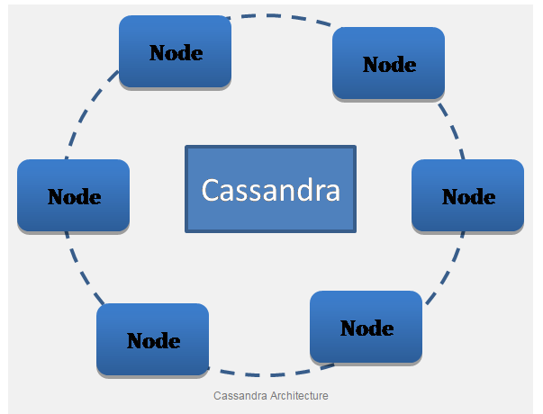
Introduction
Apache Cassandra is a open source software Distributed NOSQL database management system designed to handle large amounts of data across many commodity servers
providing high availability with no single point of failure. Cassandra offers robust support for clusters spanning multiple datacentres
With asynchronous master less replication allowing low latency operations for all clients.

Slide 4
Scalability
Scalability is the capability of a system, network, or process to handle a growing amount of work, or its potential to be enlarged to accommodate that growth.
For example, a system is considered scalable if it is capable of increasing its total output under an increased load when resources (typically hardware) are added.
An analogous meaning is implied when the word is used in an economic context, where a company's scalability implies that the underlying Business model offers the potential for economic growth within the company.

Slide 5
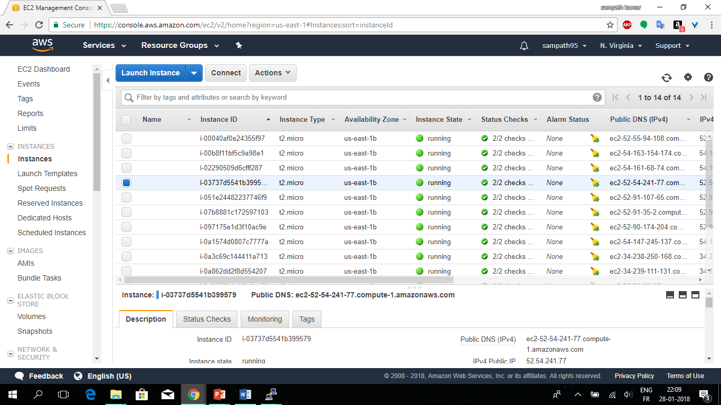
Amazon Web Services

Slide 6
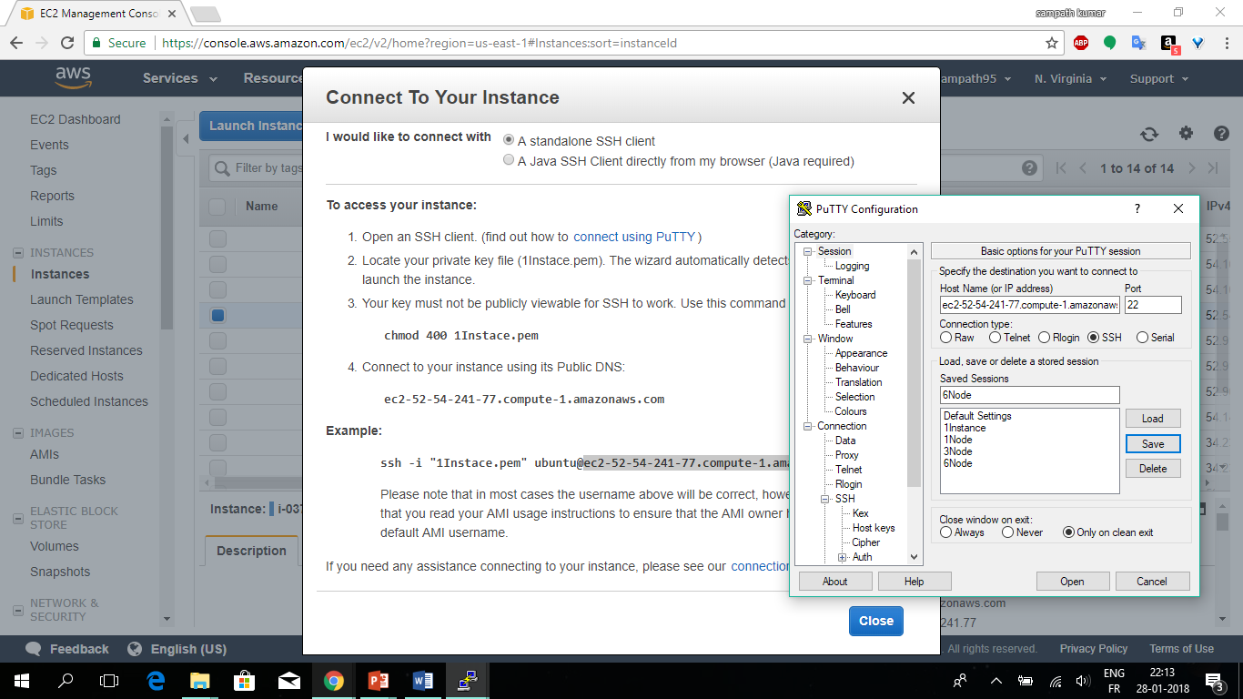
Connection with putty

Slide 7
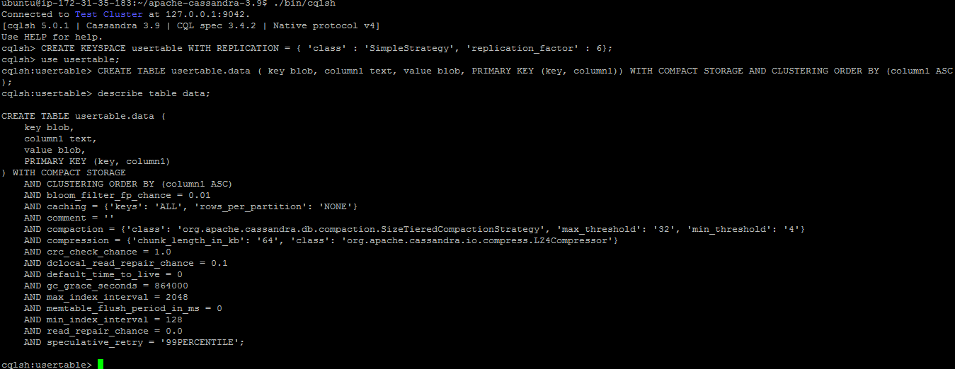
Creating Table

Slide 8
Ycsb(Yahoo Cloud Serving Benchmark) commands
./bin/ycsb load cassandra-10 -P workloads/workload_test10 -p hosts=172.31.44.1 -threads 10 -p columnfamily=data -s > results_Cassandra/load_10
./bin/ycsb run cassandra-10 -P workloads/workload_test10 -p hosts=172.31.44.1 -threads 10 -p columnfamily=data -s > results_Cassandra/run_10
./bin/ycsb load cassandra-10 -P workloads/workload_test40 -p hosts=172.31.44.1 -threads 10 -p columnfamily=data -s > results_Cassandra/load_40
./bin/ycsb run cassandra-10 -P workloads/workload_test40 -p hosts=172.31.44.1 -threads 10 -p columnfamily=data -s > results_Cassandra/run_40
./bin/ycsb load cassandra-10 -P workloads/workload_test80 -p hosts=172.31.44.1 -threads 10 -p columnfamily=data -s > results_Cassandra/load_80
./bin/ycsb run cassandra-10 -P workloads/workload_test80 -p hosts=172.31.44.1 -threads 10 -p columnfamily=data -s > results_Cassandra/run_80
./bin/ycsb load cassandra-10 -P workloads/workload_test160 -p hosts=172.31.44.1 -threads 10 -p columnfamily=data -s > results_Cassandra/load_160
./bin/ycsb run cassandra-10 -P workloads/workload_test160 -p hosts=172.31.44.1 -threads 10 -p columnfamily=data -s > results_Cassandra/run_160
./bin/ycsb load cassandra-10 -P workloads/workload_test320 -p hosts=172.31.44.1 -threads 10 -p columnfamily=data -s > results_Cassandra/load_320
./bin/ycsb run cassandra-10 -P workloads/workload_test320 -p hosts=172.31.44.1 -threads 10 -p columnfamily=data -s > results_Cassandra/run_320
./bin/ycsb load cassandra-10 -P workloads/workload_test640 -p hosts=172.31.44.1 -threads 10 -p columnfamily=data -s > results_Cassandra/load_640
./bin/ycsb run cassandra-10 -P workloads/workload_test640 -p hosts=172.31.44.1 -threads 10 -p columnfamily=data -s > results_Cassandra/run_640

Slide 9
Load for 1Node
ubuntu@ip-172-31-35-183:~/ycsb-0.12.0/results_Cassandra$ head load_10
YCSB Client 0.1
Command line: -db com.yahoo.ycsb.db.CassandraClient10 -P workloads/workload_test10 -p hosts=172.31.44.1 -threads 10 -p columnfamily=data -s -load
[OVERALL], RunTime(ms), 19672.0
[OVERALL], Throughput(ops/sec), 12990.544936966246
[CLEANUP], Operations, 10
[CLEANUP], AverageLatency(us), 48.1
[CLEANUP], MinLatency(us), 24
[CLEANUP], MaxLatency(us), 152
[CLEANUP], 95thPercentileLatency(ms), 0
[CLEANUP], 99thPercentileLatency(ms), 0

Slide 10
1Node-Run
concurrent users | Read | Read | Read | Read | Read
 | Runtime(ms) | through-put(ms) | Average latency | Min latency | Max latency
10 | 8886 | 11253.65744 | 924.1636059 | 217 | 83412
40 | 26430 | 15134.31706 | 673.5263703 | 225 | 50007
80 | 63522 | 12594.0619 | 835.2516167 | 236 | 65107
160 | 158556 | 10091.07192 | 1066.164763 | 240 | 103313
320 | 291366 | 10982.75022 | 998.123314 | 261 | 101158
640 | 2380461 | 2688.554863 | 5651.36468 | 244 | 200434

Slide 11
Graph

Slide 13
Conclusion
From this simple testing process, I can state that a single-node Cassandra instance on the provisioned server VM can sustain the high latency profile for a synthetic write-heavy workload
THANK YOU

